Slide 1
Query Completion Overview for CBIR

Slide 2
Motivation
Related work
Problem framework
Model/feature dev
Dependencies : model, data
Timeline
Future work
Minimum Viable Product

Slide 3
Motivation
Query Auto-completion System
Consider personality
Consider time-sensitivity
Based on robust query transformation probability, not only term similarity
Suggest queries and make use of feedback to improve model

Slide 4
Model
Features
Term Transition Graph
Query Classification

Slide 5
Features

Slide 6
Features:
Context
Input Query
Output Query

Slide 7
Context - Five Elements
Features:
When
Instant
A day
A month
Where （lookalike）
IP region
Who（lookalike）
Age， gender，child，city， power
What
Click through data（标题的分布比较广，不是按照标题召回）
query
Why（lookalike）
Intention classification
Note: “What” can be combined with the others to generate term context.
Term context of these element：A term context is a set of terms representing semantic information of a specific context

Slide 8
Input Query
Features:
Category prediction
Length

Slide 9
Output Query
Features:
Category prediction
CTR
PV
Length
Position number in session
Page rank score
Context relevant
Query to query:
Pairwise relevant with Input Query
Appending terms’ count or ratio
Session concurrences
Suggest position in log

Slide 10
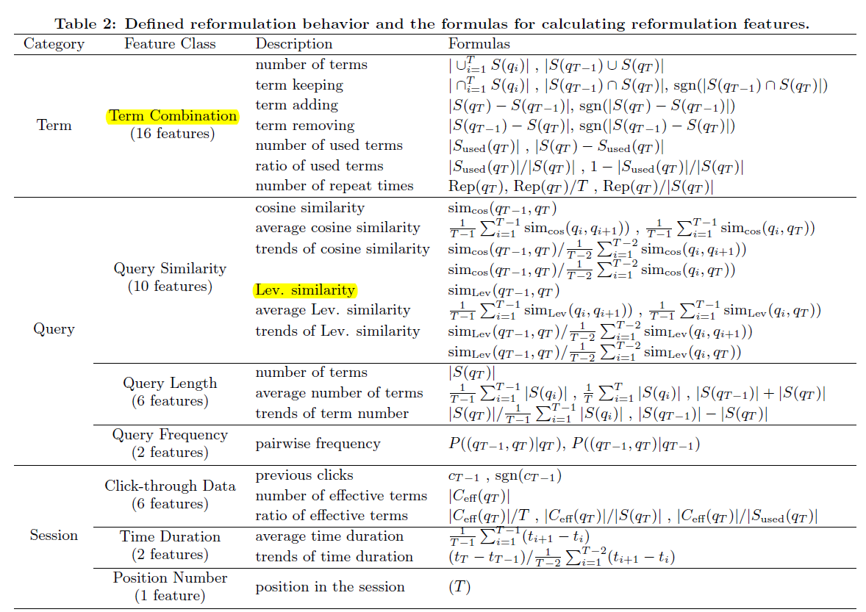
Some Supplementary
Features:
Query transformation pair features:
Term Combination
Query Similarity
Session Position Number

Slide 11
Term Transition Graph

Slide 12
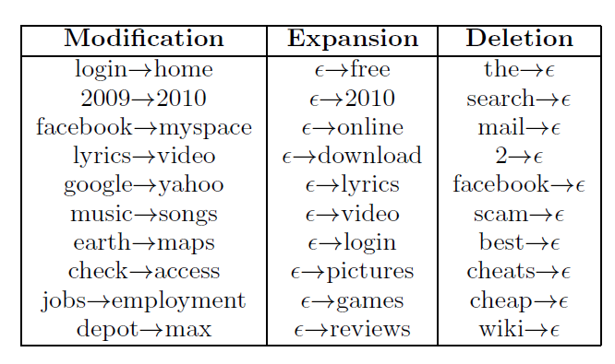
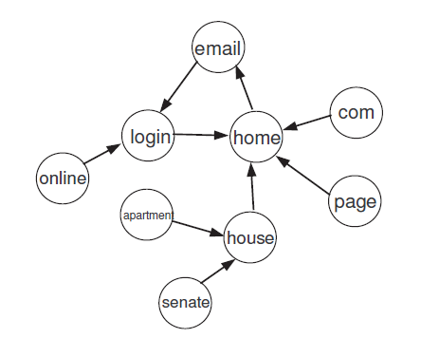

Term Transition Graph

Slide 13
Query Classification

Slide 14
Doc Based Query Classification
We have a accurate doc classification result
Create bi-part graph of query-clicked doc
Estimate query’s category by click-through doc’s category

